Slide 1
Risk Management:
Are We Stuck Inside the Box?

Slide 2
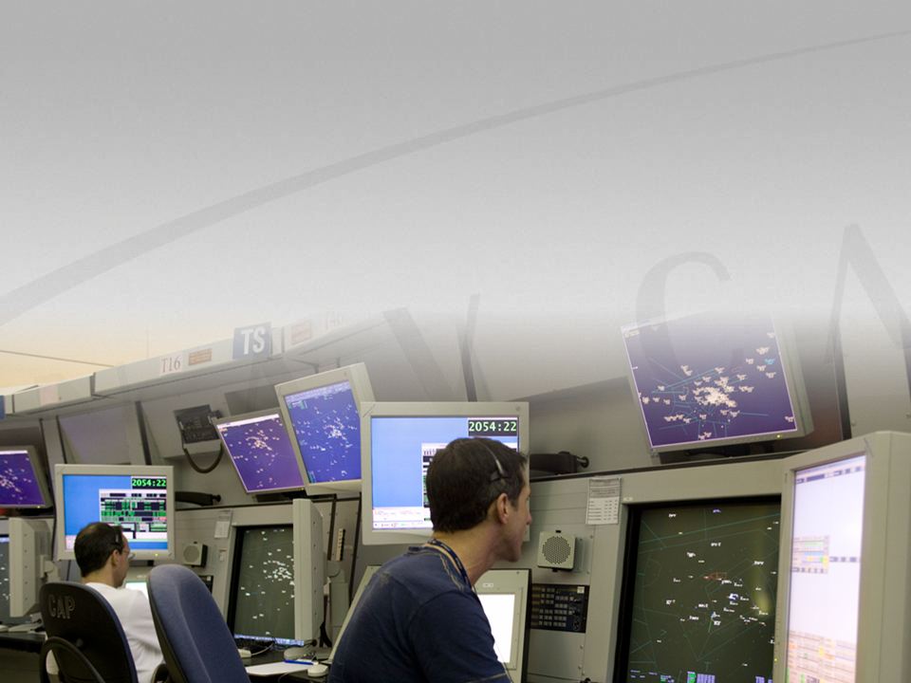
Air Navigation Service Providers Play a Vital Role…

Slide 3
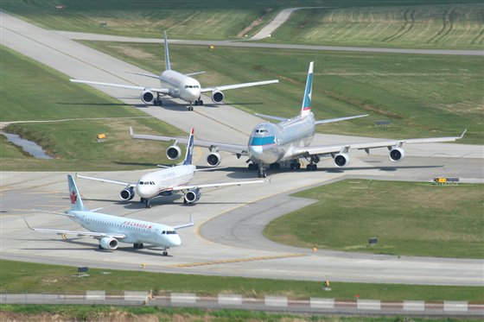
Demands for efficiency
will increase as air traffic grows

Slide 4
Role risk management plays in ANSPs increasing

Slide 5
Risk Management
Critical component of a Safety Management System
Formalised process for identifying, understanding and managing safety risk
Assures unacceptable risk is not introduced into the air traffic system

Slide 7
There will always be…

Slide 8
Challenge: Analysis Paralysis
Go beyond initial intent
Lack of clear guidance
Overcompensating
Conduct risk management assessments on everything

Slide 9
Challenge: Rote Safety Analysis
Risk Management becomes:
“Glorified Checklist” or “Cut and Paste” Exercise
Less creative, thought processes are “stuck inside the box”
Less flexible to varying needs
A box to tick-off

Slide 10
Analysis of the Solution
Starting risk management activities too late
Proving chosen design is safe as opposed to designing safety in
Not understanding the change:
How will the system be used
Treating symptoms as opposed to managing hazards

Slide 11
Knowledge, Skills & Attitudes
Challenges getting the right Subject Matter Experts
Inconsistent knowledge and application of risk management process
Having the necessary facilitation skills
Playing the “Safety Card”

Slide 12
Risk Management versus Risk Analysis
Assume Risk Analysis equals risk management:
Hazard analysis as a single event as opposed to an on-going activity
Lack of documentation
Lack of follow-up:
Mitigation implemented?
Was anything missed?
Was mitigation effective
Can we improve the process

Slide 13
Potential Solutions:
Clear and concise guidelines
Flexible approaches to risk management
Civil Air Navigation Services Organization proposing new approach
Identify hazards, where applicable use: codes of practices, reference systems and finally, explicit risk estimation and evaluation
Use a variety of processes; don’t rely on just one
Take a page from the airlines: checklists

Slide 14
Potential Solutions
Risk Management Experts
Coaching
Training
Targeted
Refresher CBT
Reinforce principles, processes, requirements

Slide 15
Potential Solutions
Better alignment and integration with business processes
Sound risk management decision making; no playing the “safety card”
Effective safety oversight
Effective continuous improvement processes

Slide 16
All Supported by a strong safety culture

Slide 17
Some Even Greater Challenges
Redirecting focus away from failures to maximizing safety benefits
Using a “common currency” of risk and its value to the organization
Considering the whole ATM system; applying a systemic approach to risk management

Slide 18
CANSO Future SMS Development Working Group
Looking at some of the challenges in SMS faced by ANSPs today
Investigating:
Common Safety Method on Risk Evaluation
Safe By Design
Advanced Approaches to Risk

Slide 19
Summary
ANSPs have many years of risk management experience
Have learned a lot but there are challenges
Potential solutions for some of the challenges exist
ANSPs must investigate and implement the ones for right for them
Take advantage of international forums to exchange and collaborate

