Slide 1

It Happened Again!
Why Accident Prevention Activities Fail
Maury Hill
Canada Chapter, ISSS

Slide 2

Road map for the evening….
A discussion of the “normal” reactions to an incident
A review of how it should have been prevented
A discussion about why the disconnect

Slide 3
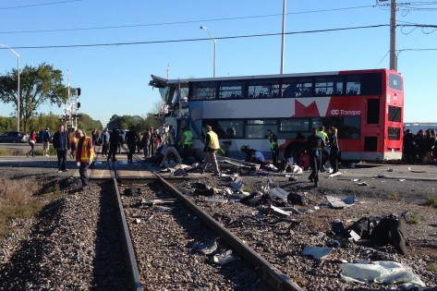
Maury Hill and Associates, Inc.

Slide 4
Normal (common) reaction
language of indignation, anger and incomprehension
counterfactual language - “should have”, “could have”, “if only”
language of judgments, of hindsight.
position of retrospective outsider
      express surprise, disbelief and indignation at how people can fail to have seen the world the way you do now

Slide 5
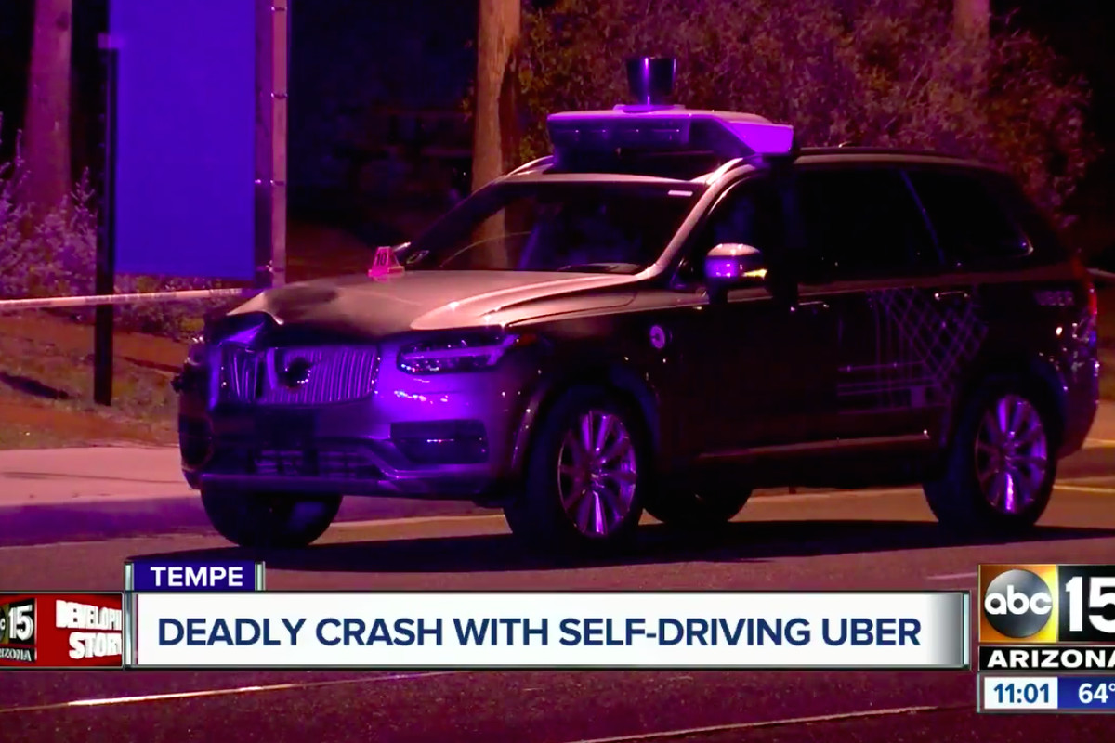

Slide 6
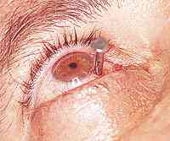
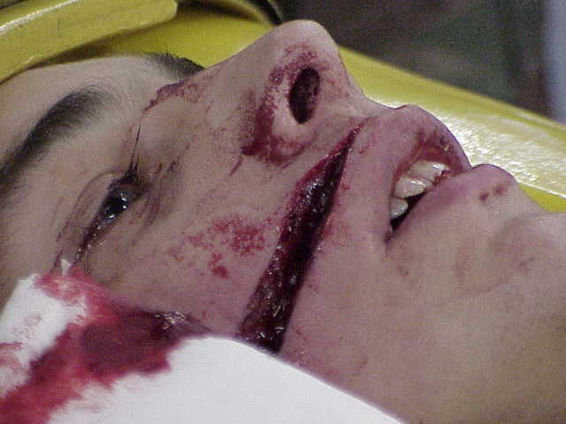
Certainly directed at the individual “victim perpetrator”

Slide 7
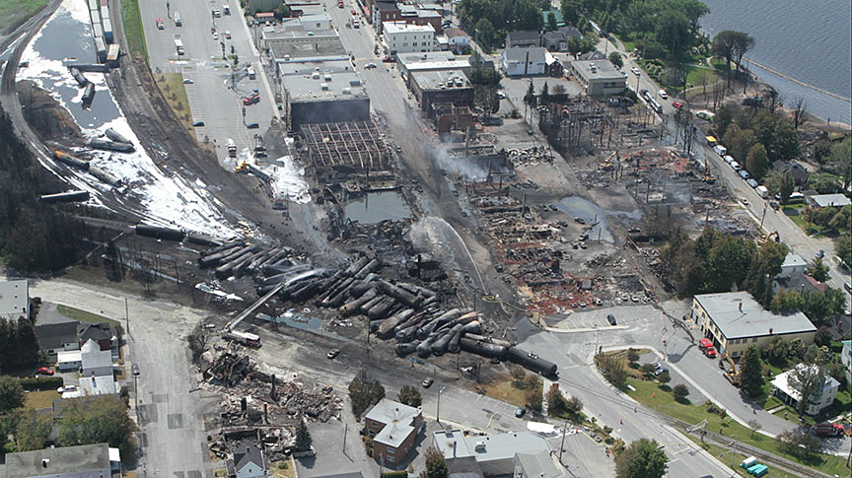

But also at major events

Slide 8
The context…
Single operator parked train, set some brakes (7)
the locomotive air brakes were left on during the brake test, meaning the train was being held by a combination of hand brakes and air brakes. This gave the false impression that the hand brakes alone would hold the train.
Firefighters shut down the locomotive in response to a fire.

Slide 9
The first kick at the can…
railway suspended the engineer for allegedly improperly setting the handbrakes on the rail cars
train engineer, manager of train operations and railway traffic controller were charged with 47 counts of criminal negligence causing death.

Slide 10
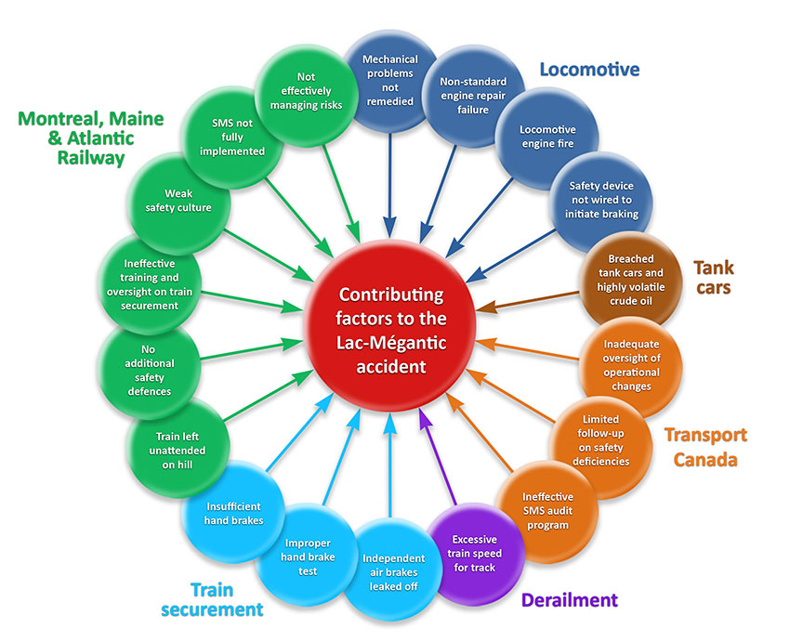

Slide 11
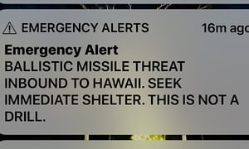
“Officials said the alert was the result of human error”

Slide 13
The context…
Hawaii has been on high emotional alert — it began staging monthly air-raid drills, complete with sirens, in December — since President Trump and Kim Jong-un, the leader of North Korea, began exchanging nuclear threats.
occurred during a shift-change drill
a flaw in the alert system delayed sending out a cellphone correction for 38 minutes

Slide 14
The first kick at the can…
“There needs to be tough and quick accountability”
“A false alarm warning was …… issued because of a “terribly designed” user interface.”
TEST MISSILE ALERT
MISSILE ALERT
BUT
“I heard the part (over the US Pacific Command secure line) “this is not a drill”. “I didn’t hear “exercise” at all in the message or from my co-workers.”
X

Slide 15
Response
New procedure was instituted requiring two people to sign off before any such alert is sent.
Cancellation button added to each menu item
Operator fired!
Manager resigned

Slide 17
The context…
Sherriff’s Office warned of an Instagram post by Nikolas Cruz in which he allegedly posed with guns and threatened to shoot up his school.
After another report, a behavioral health therapist said Cruz didn’t present immediate risk to himself and others.
YouTube user “nikolas cruz” commented on a video with his intention to become a “professional school shooter.”
The FBI received a tip by “a person close to Nikolas Cruz,” alerting them to “Cruz’s gun ownership, desire to kill people, erratic behavior, and disturbing social media posts, as well as the potential of him conducting a school shooting.” No follow up.

Slide 19
The context…
An engineer left a voicemail two days before to say some cracking had been found at one end of the concrete span
“but from a safety perspective we don’t see that there’s any issue there so we’re not concerned about it from that perspective.”
crews were applying post-tensioning force following a “stress test” when it collapsed….

Slide 20
The first kick at the can…
Detectives declared the rubble a homicide scene.
“This was a colossal failure of the system,” he said. “This was complete incompetence from the top … I want someone to step up and say, ’The buck stops with me.”’

Slide 21
How should it have been prevented?
The various tools :
Prospective
  FMECA
  Safety Cases
Retrospective
  Incident Reporting Systems
  RCA
Or both Prospective and Retrospective
  Risk Management

Slide 22
Risk Management at a glance
Identify the hazards to equipment
,
property
,
HAZARD
personnel or the organization
.
IDENTIFICATION
Identify the risk(s) and assess
the chances of it (them) occurring?
RISK ASSESSMENT
Probability
RISK ASSESSMENT
Evaluate the seriousness of the risk(s) occurring
Severity
Is (are) the consequent risk(s) acceptable and within
RISK ASSESSMENT
the organization’s safety performance criteria?
Acceptability
NO
YES
Take action to reduce
Accept the risk(s)
the risk(s) to an
RISK CONTROL/MITIGATION
acceptable level
Source ICAO

Slide 23
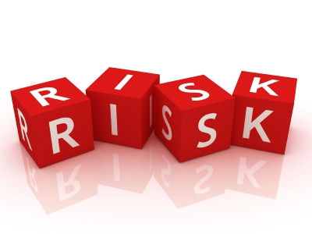
Definitions -
Hazard: The condition or circumstance that can lead to a loss (e.g. death, injury, security, reputation)
From the Arabic: al zahr - dice
Risk The consequence of a hazard, measured in terms of likelihood and severity. The chance that something is going to happen, and the consequences if it does.

Slide 24
Risk Categories
Personal
  Death/Injury (serious/minor)
Property
  Destruction/Damage (serious/minor)
-------------------------------------
Environment
  Acute/chronic damage
Business
  Brand, reputation, failure, loss
Political

Slide 25
Risk Value Judgements
At some stage, organizational values and subjective judgments enter the decision-making process and you have to consider:
The importance of the estimated risk
Associated social, environmental and economic
considerations
The potential cost of acting vs. not acting

Slide 26
Risk management
Intolerable region
The risk is
unacceptable
at any level
As
Low
Tolerable region
If the risk can
be mitigated, it
is acceptable.
Cost benefit
analysis
required.
As
Reasonably
Practicable
Acceptable
region
The risk is acceptable
as it currently stands

Slide 27
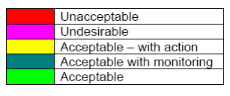
With Severity and Probability assessed, the range of response typically is as follows:

Slide 28
Risk Rating Matrix
Consequence
Likelihood
Insignificant
(1)
Minor
(2)
Moderate
(3)
Major
(4)
Catastrophic
(5)
Almost Certain
(A)
Significant
Significant
High
High
High
Likely
(B)
Medium
Significant
Significant
High
High
Possible
(C)
Low
Medium
Significant
High
High
Unlikely
(D)
Low
Low
Medium
Significant
High
Rare
(E)
Low
Low
Medium
Significant
Significant

Slide 29
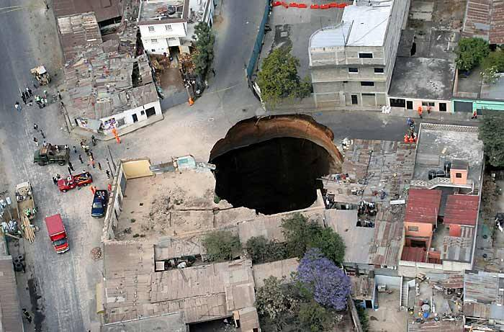
Why the disconnect?

Slide 30
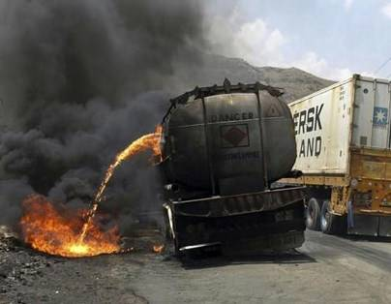
Just for fun, let’s think about….
What gets in the way of acting on issues identified?
  (or acting period?)
How can I go about disrupting the prevention of future incidents?

Slide 31


Slide 32
Challenges
The subjective nature of Risk Perception and Assessment
focus on failures rather than maximizing safety benefits
Analytic Paralysis
Playing s”safety card” rather than RBDM
Overcompensating - Conducting risk management assessments on everything
Risk Management - “Glorified Checklist” or “Cut and Paste” Exercise
Lack of alignment and integration with business processes
Deficient safety culture
Notes:
Bryce – can we re-title as “Pitfalls in Risk Assessment – Risk Perception” and start with an introductory comment indicating that risk perception is a major pitfall since many risk assessments are based on subjective analysis

Slide 33
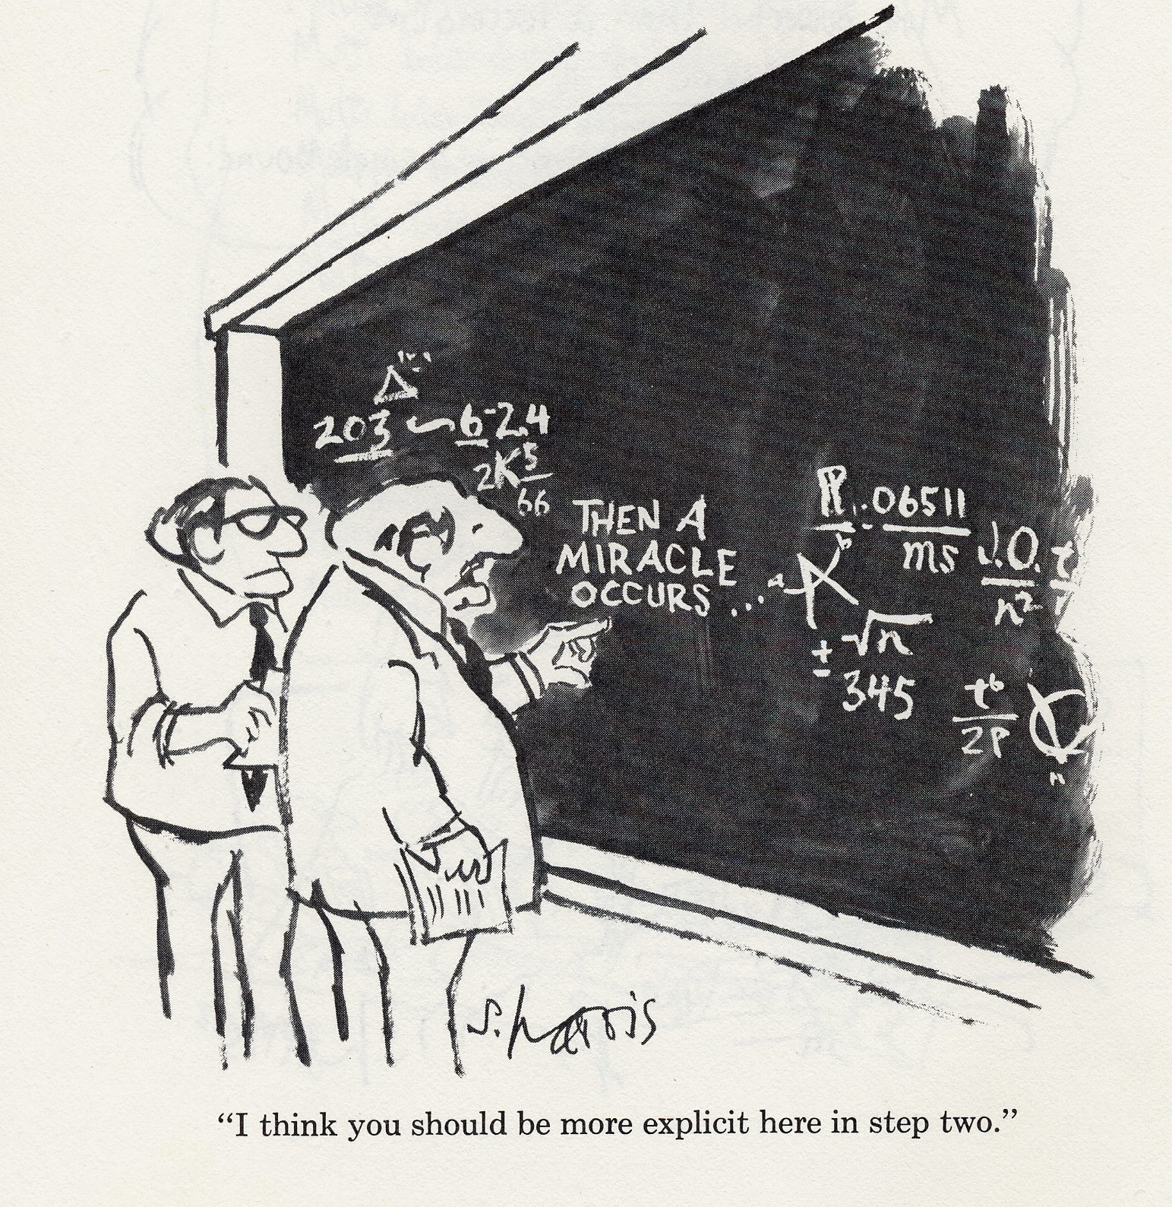
Demystify!

Slide 34
Safety Actions - Scope and Effectiveness
Acceptance of recommendations and the elimination/mitigation of hazards is directly related to an organization’s response strategy:
Deny
Repair
Reform

