Slide 1
Patient Safety in Canada
The International System Safety Society
Canada Chapter
Thursday, March 25, 2010

Slide 2
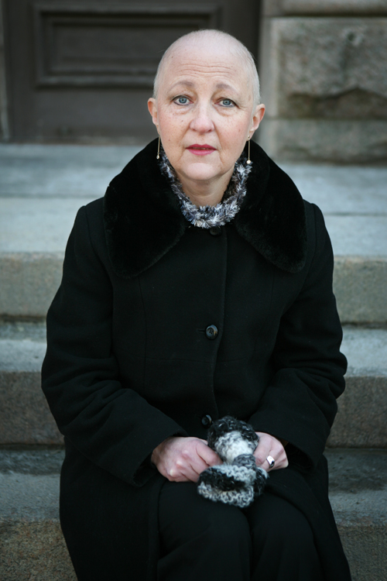
Botched tests cast doubts on cancer screening
Beverly is one of the first patients lined up to testify at the inquiry. She found a small lump in her breasts in early 2001. At the time, she was told she tested negative for a hormonal treatment that can drastically reduce chances of cancer's reoccurrence in eligible patients. By the time she learned her test results were wrong -
six years later -- it was too late for the treatment.

Slide 3
Mission & Vision
Mission:
To provide national leadership in building and advancing a safer Canadian health system
We envision a Canadian health system where:
Patients, providers, governments and others work together to build and advance a safer health system
Providers take pride in their ability to deliver the safest and highest quality of care possible
Every Canadian in need of healthcare can be confident that the care they receive is the safest in the world

Slide 4
Milestones of the Modern Era
Harvard Medical Practice Study
Quality in Australian Health Care Study
1996 Annenberg conferences begin
1999 Colorado / Utah Study
1999 IOM Report: To Err is Human
2000 BMA/BMJ London Conference on Medical Error
SAEM: San Francisco Conference on EM Error
British study
____________________________________________
2001-3 Halifax Symposia on Medical Error
2001 RCPSC National Steering Committee on Patient Safety
RCPSC Report: Building a Safer System
Canadian Patient Safety Institute & Baker Norton Study
2006 6th Canadian Symposium on Patient Safety (Vancouver)

Slide 5

Canadian Adverse Events Study
9-24,000
1,100,000
Deaths among patients with preventable adverse events
Extra hospital days associated with adverse events

Slide 6
What We Know
One in ten adults contract infection in hospital
One in ten patients receive wrong medication or wrong dose
More deaths after experiencing adverse events in hospital than deaths from breast cancer, motor vehicle and HIV combined

Slide 7
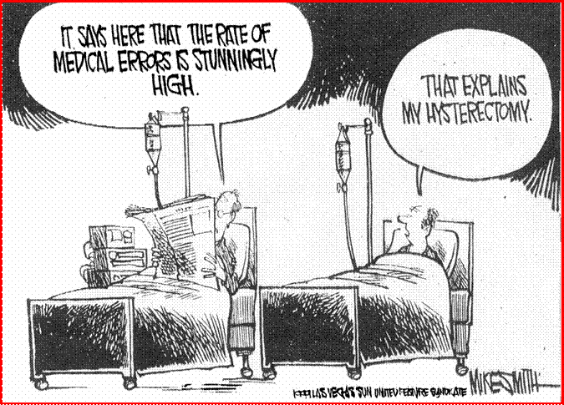

Slide 8
Risky Activities (Adapted by Dr. Philip Hebert)
15,000 deaths/yr
Dangerous (>1/1000)
Regulated
Ultra-safe (<1/100K)
100,000
Hospitalization
10,000
Driving
Total Lives Lost per year
Offshore rig
1,000
Commercial airlines
Coal Mining
100
timber
Firearms
truckers
Rock Climbing for 25 hrs
construction
10
Bungee Jumping
Scuba diving
1
10
100
1000
10,000
100,000
1,000,000
10,000,000

Slide 9
How Does Canada Compare?
 | Year | AE Rate (%) | Preventable (%)
New York | 1984 | 3.7 | n/a
Utah/Colorado | 1992 | 2.9 | n/a
Australia | 1992 | 16.6 | 51
New Zealand | 1998 | 13.1 | 37
United Kingdom | 1999 | 10.8 | 48
Denmark | 2000 | 9.0 | 40
Canada | 2001 | 7.5 | 37
Netherlands | 2004 | 5.6 | 40
Sweden | 2003/4 | 12.3 | 70

Slide 10
Patient Safety: Barriers to Action
Access is more urgent in Canada
Shortages of clinical professionals
Concern about liability
Jurisdictional conflicts
Delays in building the EHR
Culture of patient safety is lacking
Victims are nameless & faceless
Difficulty recognizing errors
Fragmentation of care delivery hampers system thinking
Lack of information systems to identify errors
Other
Relationship of trust with providers (blame culture)

Slide 11
A Culture of Safety
31,033 Pilots, Surgeons, Nurses and Residents Surveyed
Questions (% Positive Responses) | Pilots | Medical
Is there a negative impact of fatigue on your performance? | 74% | 30%
Do you reject advice from juniors? | 3% | 45%
Is error analysis system-wide? | 100% | 30%
Do you think you make mistakes? | 100% | 30%
Easy to discuss/report mistakes? | 100% | 56%
    Sexton J. B., Thomas E. J., & Helmreich R. L. Error, stress and teamwork in medicine and aviation: cross sectional surveys. British Medical Journal, 3-18-2000.

Slide 12

Human Factors: Fatigue
24 hours without sleep
  Is equivalent to a blood alcohol level of 0.10,
  a 30% decrease in cognitive processing
After 12 hours on the job
  Nurses are 3 times more likely to make mistakes
When on traditional 24 hour call schedules
  Interns made 30% more errors in ICU patients
Teamwork is the best countermeasure for fatigue
Three major disasters related to night time workers - Exxon Valdez, Chernobyl, and Three Mile Island
Leonard, M. (Nov. 2005). Safer Healthcare Now Presentation.

Slide 13
Association Between Evening Admissions and Higher
Mortality Rates in the Pediatric Intensive Care Unit
Arias, Y., Taylor, D. S. & Marcin, J. P. (2004). Pediatrics. 113: 530-534.

Slide 14
Safety Issues:
Look Alike, Sound Alike Drug Names
Epinephrine
Ephedrine
Amrinone
Amiodarone
Phenylephrine
Phentolamine

Slide 15
Human Error – the New View
“The point of an investigation is not to find where people went wrong.
It is to understand why their assessments and actions made sense at the time.”
Dekker, S. (2002). The Field Guide to Human Error Investigations.

Slide 16
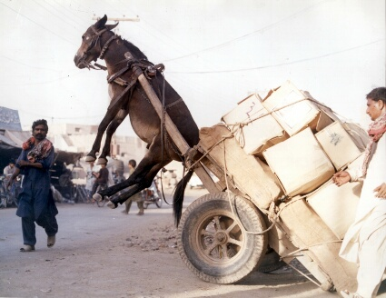

Slide 17
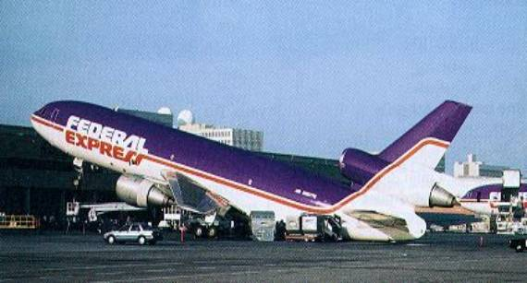

Slide 18
A Systems Approach
“The systems approach is not about changing the human condition but rather the conditions under which humans work.”
Reason, J. T. (2001).

Slide 19
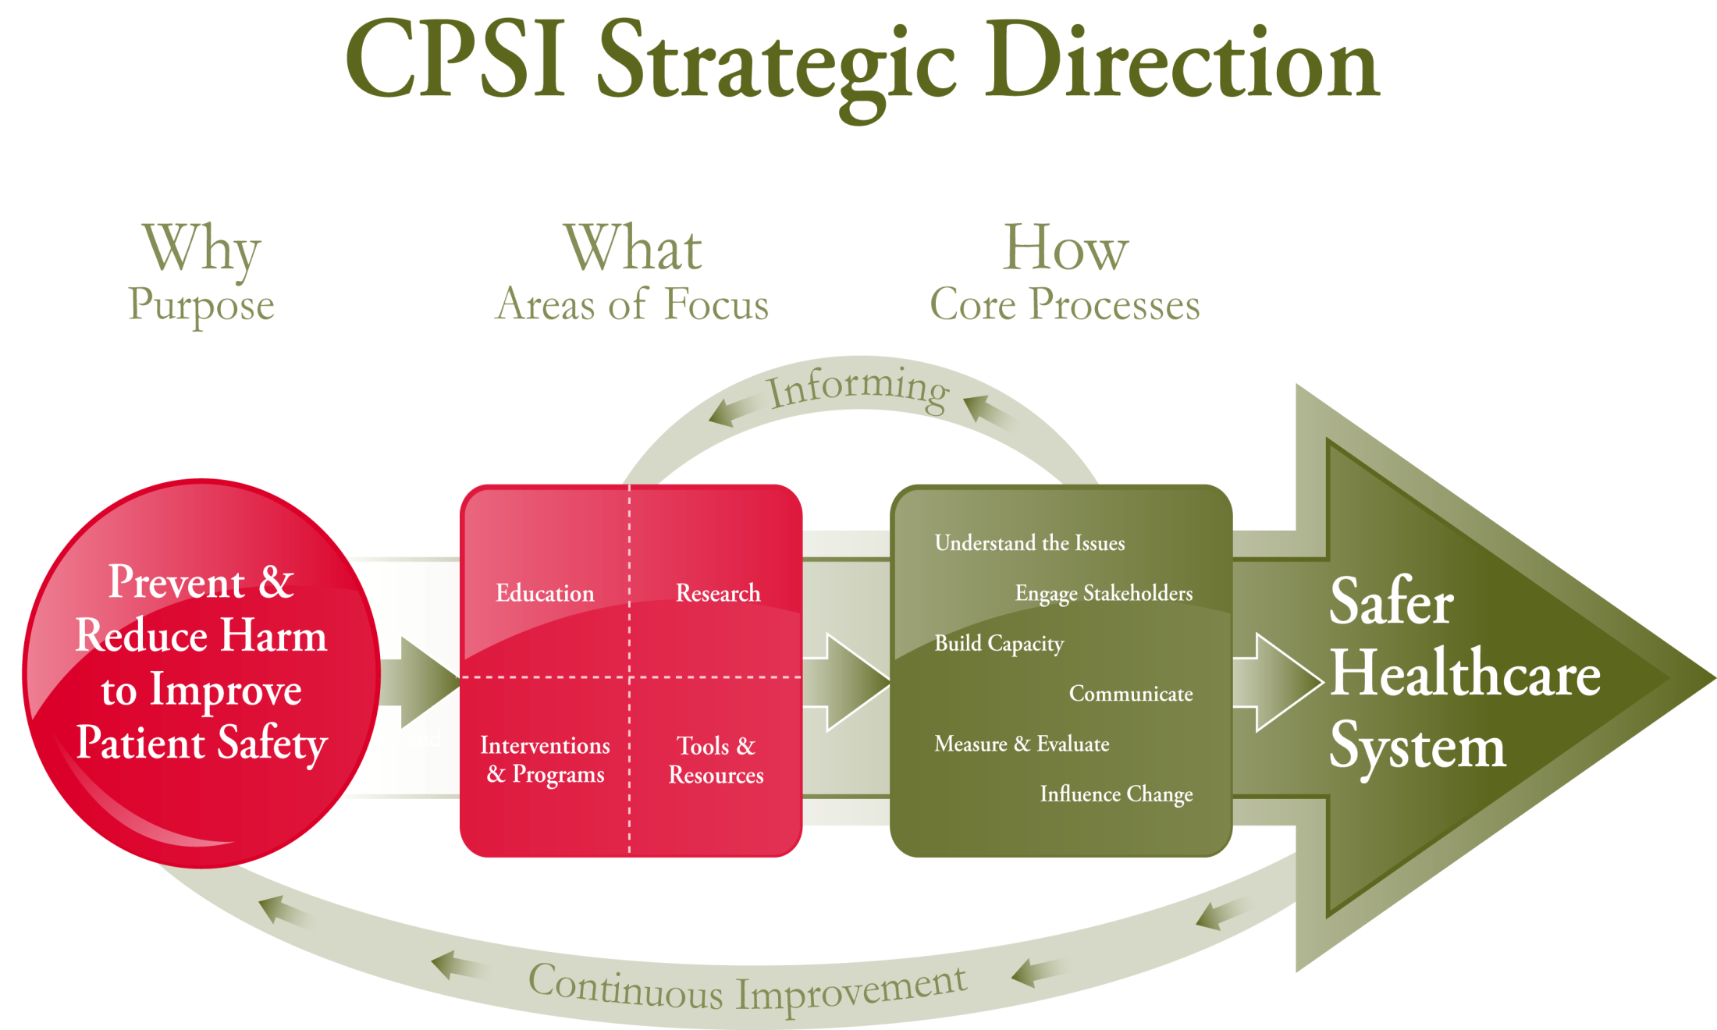
Strategic Directions

Slide 20
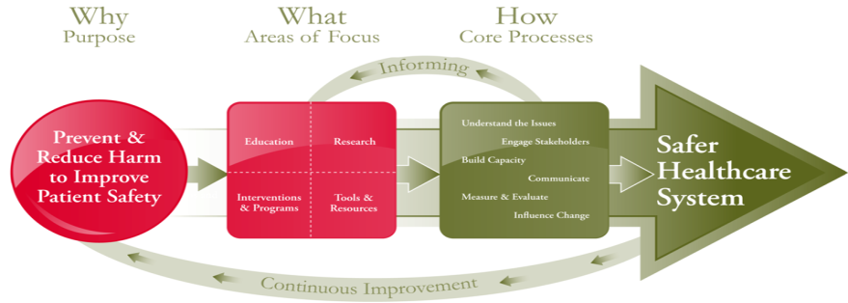
Strategic Directions
Why? Purpose
Prevent and reduce harm to improve patient safety
What? Area of Focus
How? Core Processes
Education
Research
Interventions & Programs
Tools & Resources
Understand the issues
Engage stakeholders
Build capacity
Communicate
Measure & Evaluate
Influence change

Slide 21
CPSI Strategic Direction
.
Education Executive Patient Safety Series Governance for Quality and Safety Canadian Patient Safety Officer Course Simulation Studentships Halifax Conference Patient Safety Competencies Canada’s Forum on QI and Patient Safety | Research Home Care Long Term Care Mental Health Services Emergency Medical Services Primary Health Care Building Capacity through Research
Interventions & Programs World Health Organization High 5’s Patients for Patient Safety Canada Infection Control Hand Hygiene Campaign Safer Healthcare Now! | Tools & Resources Event Analysis Electronic Health Record Canadian Disclosure Guidelines Canadian Adverse Event Reporting and Learning System WHO Safe Surgery Saves Lives Human Factors Teamwork and Communication Bar Coding

Slide 22
Education
Board and Executive
Governance for Quality and Patient Safety
PSO
Canadian Patient Safety Officer Course
Front-Line Staff
Patient Safety Education Project
The Safety Competencies
Delivering Patient Safety DVD Series
Simulation

Slide 23

Education: Patient Safety Competencies
Objective: Support the dissemination and integration of The Safety Competencies Framework in health professional education and practice
Contribute to a Culture of Patient Safety
Work in Teams for Patient Safety
Communicate Effectively for Patient Safety
Manage Safety Risks
Optimize Human and Environmental Factors
Recognize, Respond to and Disclose Adverse Events

Slide 24
Delivering Patient Safety - DVD Series
DVD 1 – Facing the Facts
DVD 2 – Changing the Culture
DVD 3 – Why Things Go Wrong
DVD 4 – Building Resistance to Error
DVD 5 – A Safer System
DVD 6 – Leading & Learning
CD 7 – Support Materials
Notes:
Our committee reviewed several existing audiovisual resources from a variety of sources. This resource, originally developed for a UK audience was critiqued and massaged in order to ensure the messaging spoke to a Pan-Canadian audience – yet underlines the importance of utilizing evidence based, standardized approaches to patient safety and quality improvement….many healthcare organizations are now utilizing this resource as part of their overall education and professional development curriculum, not only geared to front-line healthcare providers but those in both organizational and board leadership positions.

Slide 25

Education: Simulation
Objective: to formally promote and endorse the use of simulation as a means to education interprofessional healthcare teams and to establish a national coordinating body for simulation efforts
CNSH Steering Committee
CPSI Support
Build the Network Working Group
Programs for Non-Technical Skills Working Group
Programs for Educational Development Working Group
Developing and Promoting Guidelines Working Group
Canada’s Simulation Community

Slide 26
Education: Emerging Issues
Native, Inuit and Métis Patient Safety
Health Literacy
Optimal Prescribing
  Identify opportunities to improve patient safety in specific settings/areas

Slide 27
Research: Building Capacity
Over 60 research and demonstration projects have been funded in the last three years
  Form the basis for new knowledge of Canadian patient safety challenges and solutions
Development of background papers
  To identify the current state of knowledge, future research priorities, key issues, strategies and opportunities for action and improvement
Mental Health
Emergency Medical Services
Primary Health Care
Home Care
Long Term Care

Slide 28

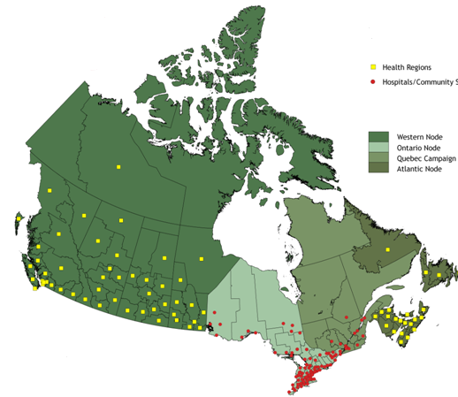
Interventions & Programs
In Canada . . .
33 million people
10 interventions + 2 pilots
1084 teams enrolled
80% of acute care hospitals enrolled
All regional health organizations outside of Quebec enrolled Aim
Reduce adverse events by
40-100% according to intervention
www.saferhealthcarenow.ca

Slide 29
Safer Healthcare Now Interventions
Initial Interventions Improve Care for Acute Myocardial Infarction Prevention of Central Line Associated Bloodstream Infection Medication Reconciliation Rapid Response Teams Prevention of Surgical Site Infection Prevention of Ventilator-Association Pneumonia
New Interventions Prevention of Adverse Drug Event in Long-Term Care Prevention of Harm from Falls in Long-Term Care Prevention of Harm from MRSA Improve Care for Venous Thromboembolism (VTE) Pilot Projects Prevent Adverse Drug Events Related to High Risk Medication Delivery in Paediatrics Prevent Adverse Drug Events Through Medication Reconciliation in Home Care

Slide 30
Teams Continue to Enroll
Total at January 20, 2010

Slide 31
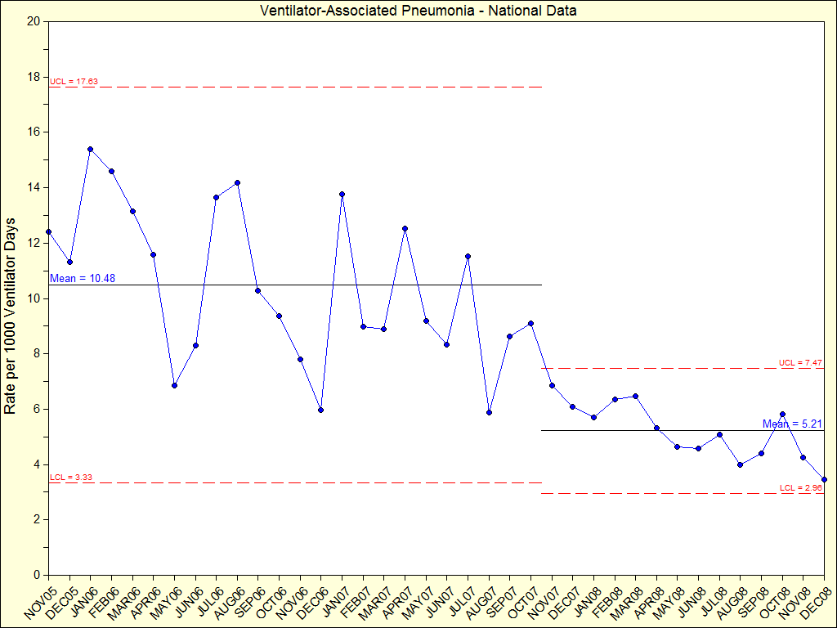
Ventilator-Associated Pneumonia
Between Nov/05 and Oct/07, Safer Healthcare Now! teams decreased the rate of ventilator-associated pneumonia (VAP) per 1000 ventilator days by more than 50 per cent
VAP rate has dropped from an average 10.48 to 5.21
The average number of teams reporting monthly data to Safer Healthcare Now! has increased from 31 in the first two years to 50 last year
Safer Healthcare Now! teams improve care to ventilated patients

Slide 32
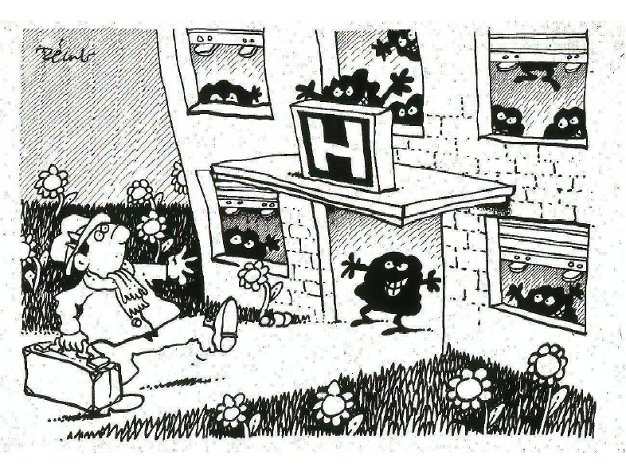
Infection Control

Slide 33
Hand Hygiene
Objective: Promote the importance of hand hygiene in reducing healthcare associated infections and provide capacity building and leadership development with tools and resources
  Hand hygiene tool kit
  Human factors hand hygiene tool kit
  DiscoveryCampus online training module
  Hand hygiene compliance audit tool and training
  WHO Patient Safety Challenge May 5, 2010
  Six Sigma Pilot Project

Slide 34
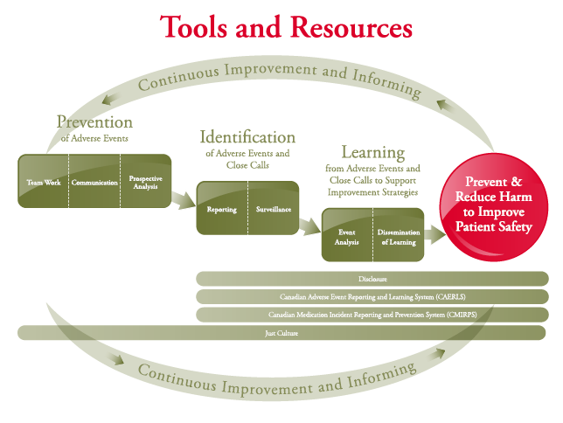

Slide 35
WHO Reporting and Learning & Taxonomy
Objective: International sharing and learning from adverse events through a shared taxonomy and classification system.
Strategies:
CPSI lead collaboration on mechanism for identifying , sharing & learning.
Development of an international framework to share alerts, advisories, & other information related to adverse event reports.
International collaboration on event analysis.
CPSI involvement in the creation of the International Classification for Patient Safety.
35

Slide 36
Disclosure
Goal: The Canadian Disclosure Guidelines were support healthcare providers, organizations, and patients understand the elements of and process for disclosure of an adverse event once it has occurred.
Strategies:
Through the teamwork and communications working group:
  Develop a strategy for ensuring disclosure training is available to organizations and frontline providers who require it
  Further development of multi-party disclosure processes
  Further promote the Guidelines to patients and providers.
36

Slide 37
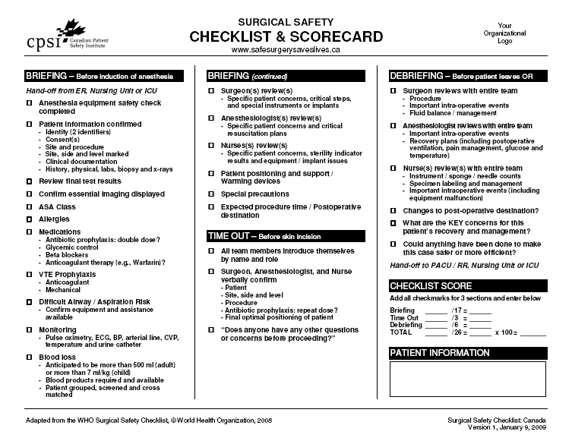
Safe Surgery Saves Lives
Goal:
sustainable improvement in surgical safety
Strategies:
Spread the use of the Checklist (+60% of ORs)
Align the Checklist with other initiatives (SHN)
Design effective implementation resources
37

Slide 38

Patients for Patient Safety Canada
Goal: Build a reputable organization that can bring a credible patient voice to healthcare improvement
Strategies:
Brand and awareness building
Build partnerships
Strengthen membership
38

Slide 39

On culture . . .
Marc Bard (n.d.)
“Culture eats strategy
for lunch
over and over again.”

Slide 40

Commitment to Our Patients
“. . . there are some patients we cannot help,
there are none we should harm. . .”
Dr. Ken Stahl

Slide 41
Want to know more?
ltaylor@cpsi-icsp.ca
The Canadian Patient Safety Institute would like to acknowledge funding support from Health Canada. The views expressed here do not necessarily represent the views of Health Canada
Notes:
41

