Slide 1
Inspiring Growth and Good Governance in an ISSS Chapter
Prepared by: Robert W. Fletcher
Director, Chapter Services & International Outreach
International System Safety Society

Slide 2
Thank you / Introduction
It is a privilege to be able to speak to you all
Robert Fletcher;
M.Sc. (USN PG School, Monterey, CA), P.Eng., PMP, PCIP, Aviation Lead Auditor
RCAF - Systems Engineer; DND, Transport Canada / NAV CANADA - System Safety; Consultant - System Safety Engineering
Volunteer, Director Chapter Services & International Outreach; attended ISSS conferences since 1998 (for past 20 years) …
Married to Joan for the past 46 years, 2 sons ages 39 & 37; Chad, an investment advisor for the TD Bank, Joshua, a software engineer for General Dynamics Canada; 2 daughters-in-law (Karen & Sirikorn) and 3 grandchildren (Caleb 5; Ada 3 & Nathan ~1 ☺ !!!)

Slide 3
Reflections by Several Chapter leaders
Virtual C – Lee Flint
NE Chapter – Pam Alte
TVC- Don Swallom
WDC – Donne Difiglia (to brief on System Safety and Software Engineering 101 course for Chapter Presidents)

Slide 4
Seeking to make us think …
Please save your comments and questions until the end …
Please make notes of your thoughts / suggestions as I go through my slides
You may not agree with some of my thoughts … discussion is good ☺ !
I am trying to get your involvement …
Saving the ISSS or recreating it may be at stake …?

Slide 5
Who are we? What do we believe?
Vision
Mission
Objectives / Values

Slide 6
Vision Statement
To make the world a safer place through safer systems.

Slide 7
Mission Statement
Advance the system safety discipline by creating an international, interdependent network (need chapters) of system safety professionals dedicated to the continuous improvement of the art, sciences and technology needed to provide the best total system safety solutions.
Be the recognized international leader in the system safety discipline.

Slide 8
Objectives (Values) of the International System Safety Society:
To advance the art and science of system safety
To promote a meaningful management and technological understanding of system safety
To disseminate advances in knowledge to all interested groups and individuals (need chapters)
To further the development of (all) the professionals engaged in system safety (need chapters)
To improve public understanding of the system safety discipline
To improve the communication of system safety principles to all levels of management, engineering and other professional groups

Slide 9
ISSS Situation
Membership has decreased from 1000+ to 420 (in 2018) in the past few years
Chapters have decreased from 20+ to 15
one closed (Twin Cities) last year
others may close in the near future
benefit of chapters is that it brings in new younger members by personal interaction and quality local presentations
ISSS Objective: “To further the development of (all) the professionals engaged in system safety”

Slide 10
Leadership … vision, goals, inspiration ???
the art of motivating a group of people (chapter members) to act towards achieving a common goal ...
ability to inspire others
the leader (President of a Chapter) is the inspiration and director of the action. He or she is the person in the group that possesses the combination of personality and leadership skills that makes others want to follow his or her direction

Slide 11
Best type of Leadership for Chapters
- like a Major / LCol in military field operations with a technical background
- some people are better suited for Head Office type leadership; more document structured and less people oriented

Slide 12
Inspiring Leadership: people centric
The leader is able to;
Face challenges
Win trust
Be authentic
Earn respect
Stay curious i.e. open to new ways of doing things

Slide 13
ISSS Situation …
Some people do not want to become members or to serve in chapter leadership positions? Ask why?
Some people do not want to volunteer to serve in the ISSS leadership positions at the Chapter level? Ask why?
Generations: have different expectations
Baby Boomers; ages 50 – 70 (born 1947+)
Nxers; ages 35 – 50 (born 1967+)
Millennials; ages 20 - 35 (born 1980+)

Slide 14
Why do People Want to Volunteer for the ISSS?
To join an engineering organization that works to make this a safer world !
Opportunity to develop qualities that are required at senior level
President
Vice President
Treasurer
Secretary
Program Chair
* Some people will join ISSS if asked; the recruiting style is important ☺ !

Slide 15
Why people volunteer …
1. People like to make a difference.
2. Volunteering makes people feel better.
3. People like to learn.
4. Chapter level volunteers are “people-people”; … networking is important and meaningful to them
5. People love to support their favorite causes.
6. Volunteers love to be active.
7. Everyone likes perks ... opportunities to meet accomplished people; represent a chapter, opportunity to initiate one’s ideas.
8. Some folks love seeing how things work

Slide 16
Why do People Not Want to Volunteer or Lose Interest in the ISSS?
Refuse
too busy with job & family & personal hobbies
do not like leadership responsibilities
do not see the value in getting together (networking) compared to using the internet
Lose interest
system safety engineering info is available on internet
virtual meetings easier than face to face
poor leadership locally (no vision or inspiration to motivate)
lack of vision to motivate a newcomer
friction in relationships
retirement mindset; golf everyday, travel, grandkids, etc. …

Slide 17
Rules to maintain a Chapter
Need 4 people in key positions (P, VP, T, & S)
Must be paid up members – some people will serve as leaders but do not want to pay the $130.
Chapter must submit an Annual Report by 15 July
Annual Report can be somewhat onerous and time consuming. Chapter 10 – Financials has been a problem for some chapters (i.e. submitting all receipts)

Slide 18
ISSS Situation
What can be done?
vision casting during the EC & Annual Conference
introduce leadership training
improve recruiting of new leaders & members at a chapter level
improve advertising, marketing, promotion to attract new members and promote chapter activities
develop a focus on increasing # of chapters and members
encourage more virtual interaction between large & small chapters
prepare a sample System Safety & Software Engineering 101 course for Chapter Presidents to use

Slide 19
ISSS Situation - Strong Chapters
North East
Sierra High Desert
Singapore
Tennessee Valley
Virtual
Washington DC
New Mexico (revitalized & hosted conference last year)
Saguaro, Arizona (revitalized last year)
Canada (held 3 presentations this year, signed up new President, VP, Secretary, Treasurer in June 2018)

Slide 20
Chapters that are not Strong …
Bay Area (California)
Central California
Southern California
Georgia (may need to be closed)
Houston (in process of being closed)
North Texas (will try to revitalize in 2018 / 2019)

Slide 21
Other similar organizations
Are they experiencing similar declines?
INCOSE - International Council On System Engineering
SRE - Society of Reliability Engineering
ASSE - American Society of Safety Engineers / new name - American Society of Safety Professionals (ASSP)
CSSE - Canadian Society of Safety Engineers / new name - Canadian Society of Safety Professionals (CSSP)
PEO - Professional Engineers of Ontario
PMI – Project Management Professionals
HFE Group – Human Factors Ergonomics
Not all of them; INCOSE still growing rapidly internationally

Slide 22
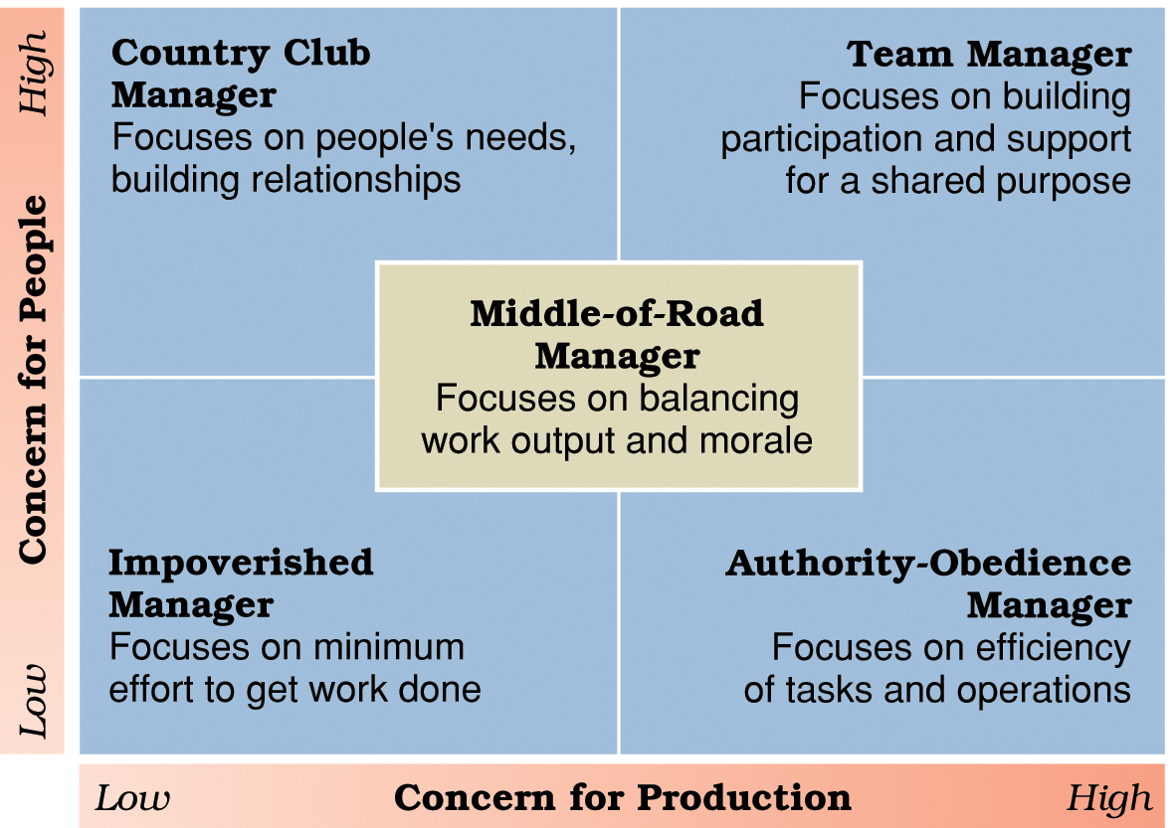
Leadership styles in Blake and Mouton’s Leadership Grid.

Slide 23
Blake and Mouton Leadership Grid®
Team management.
High task concern; high people concern.
Authority-obedience management.
High task concern; low people concern.
Country club management.
High people concern; low task concern.
Impoverished management.
Low task concern; low people concern.
Middle of the road management.
Non-committal for both task concern and people concern.

Slide 24
Teamwork Doesn’t Come Naturally
Barriers
Some value individualism (concerned about getting credit for work done) over teamwork
Conflict can cause a breakdown in relationships
Heavy workloads and long hours cause weary people
Teamwork flourishes under strong (balanced but strong people & task) oriented leadership

Slide 25
The nature of inspiring leadership?
Visionary leadership.
Vision
A future that one hopes to create or achieve in order to improve upon the present state of affairs.
Visionary leadership
A leader who brings to the situation a clear and compelling sense of the future as well as an understanding of the actions needed to get there successfully.
A leader provides the needed inspiration to follow

Slide 26
The nature of leadership … ?
Meet the challenges of visionary & inspiring leadership:
Willing to face challenges
Show enthusiasm
Help others to act
Set the example
Celebrate achievements

Slide 27
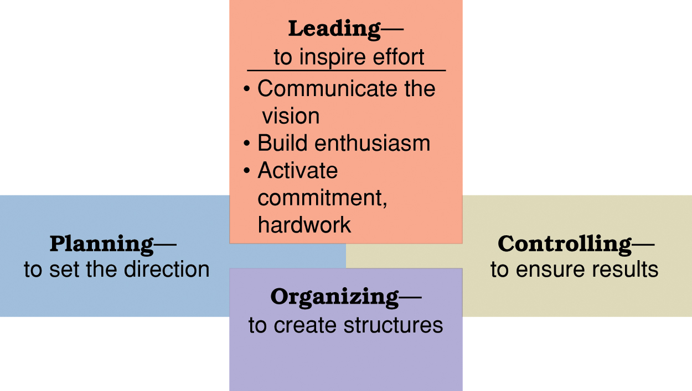
Leading viewed in relationship to the other leadership / management functions – “leading” is often missing.

Slide 28
Quote - John Maxwell
Great challenges require great teamwork, and the quality most needed among teammates amid the pressure of a difficult challenge is collaboration….
Each person brings something to the table that adds value to the relationship and synergy to the team.
John C. Maxwell
Author, The 17 Essential Qualities of a Team Player

Slide 29
My ongoing desire … Future Director ???
As Director of Chapter Services & International Outreach to;
- establish new chapters in the USA and in international locations,
- revive chapters that have become inactive, and
- maintain and grow all the existing chapters.

Slide 30
As Director of Chapter Services and International Outreach …
I will seek to help the International System Safety Society (ISSS) grow strong harmonious chapters with a passion for the mission, vision, and values by inspiring leadership in people to help others to reach their full potential within all of USA, Canada, and all countries aligned with shared values. I will seek to build bridges between people from all nations and organizations where the relationships will enhance and strengthen the ISSS.
Some specific goals are to;
encourage ISSS Regional Conferences throughout the world,
coordinate international system safety training and educational opportunities,
increase attendance at ISSCs and ISSRCs,
nurture positive relationships with other system safety organizations in the world; e.g. IET, INCOSE, ASSE, CSSR, Human Factors/Ergonomics, RAMS, etc.
encourage development of certification standards in system safety engineering,
encourage leadership in the system safety discipline,
expand the ISSS’s representation in government, industry, academia,
encourage high quality content at ISSCs
support development of state-of-the-art system safety engineering techniques and methods,
encourage articles in the Journal of System Safety, and
develop a vision for expanding the Society internationally.

Slide 31
References
http://www.drbobhurley.com/pdf/selfmgc3l.pdf
Book on Management: Houghton Mifflin Co.
Chapter 13: Leading Public & Volunteer Organizations; Cummins, Strickland & Vaughan, Clarke, Allison
Developing ISA Volunteers for Organizational Success
References:
1. Supervising Volunteers, ISBN 0-940576-20-1, 155 pages, <$20, Energize, Inc., 1999
2. The Volunteer Recruitment Book, ISBN 0-94-576-25-2, 155 pages, <$20, Energize, Inc., 2002
3. Leadership Skills – Developing Volunteers for Organizational Success, ISBN 1-55561-
066-8, $20, Fisher Books, 1994
Material summarized and additional comments by Paul Gruhn

Slide 32
Any comments / questions
comments / questions ?

